Slide 1

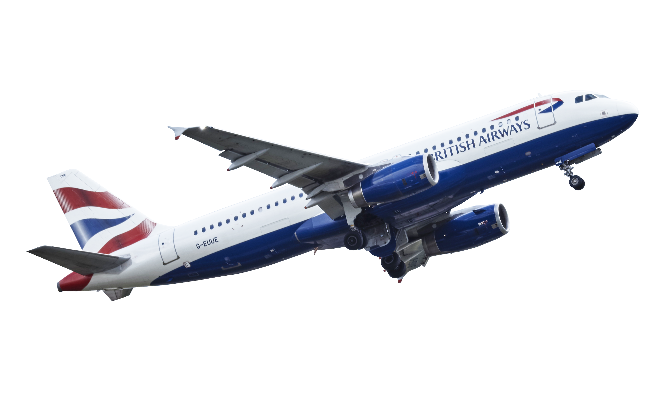

FLIGHT BOOKING SYSTEM
PRESENTED BY
JOBIT THOMAS
22PMC133

Slide 2

ABSTRACT
The Flight Booking System is a Django-based web application that provides users with the ability to search for and book flights. The system aims to simplify the flight booking process by offering a user-friendly interface and a comprehensive set of features. The application allows users to create an account, search for available flights based on various criteria such as destination, departure date, and number of passengers. It provides real-time flight information, including flight schedules, seat availability, and fares. Users can select their preferred flights, choose their seats, and proceed to the booking and payment process. The application is developed using the Django framework, which provides a robust and scalable foundation. Django's built-in features, such as ORM (Object-Relational Mapping) and template engine, are utilized to streamline the development process and create efficient database interactions and dynamic web pages.

Slide 3

PROJECT REQUIREMENTS
User Registration
User Login
Find Flight
List Of Flight
Booking Ticket
Make Payment
Cancel Bookings
Logout
Admin Can Add Flight
Admin Can Delete Flight
Admin Can See Bookings
Admin Can Logout

Slide 4

FEATURES AND HIGHLIGHTS
USER REGISTRATION: This feature allows new users to create an account on the flight reservation system by filling in their personal information such as username, first name, last name, email, phone number, and password. After successful registration, users can log in to the system to access the flight booking and other related services.
USER LOGIN: This feature allows users who have already registered with the system to log in using their credentials, such as username and password.
FIND FLIGHT: This feature enables users to search for flights based on various criteria such as departure location, destination and travel date.
LIST OF FLIGHT: This feature provides a comprehensive list of available flight that match the search criteria entered by the user. Users can view the flight details such as flight number, fare, available seats, and travel time.
BOOKING TICKET: This feature allows users to enter number of seats on the flight and confirm their booking.
MAKE PAYMENT: This feature enables users to make payment for their bookings.
CANCEL BOOKINGS: This feature allows users to cancel their bookings if they have a change of plans or for any other reason.
LOGOUT: This feature allows users to log out of the system securely after completing their bookings or other activities.

Slide 5
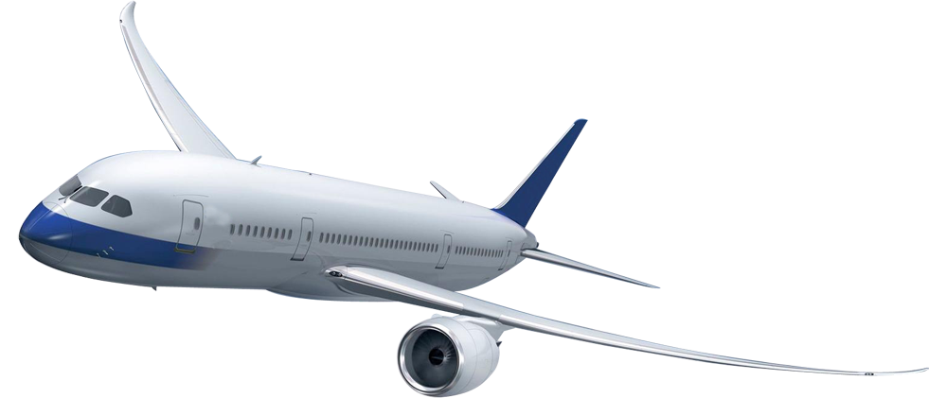
TECHNICAL ASPECTS
Programming Language
Web Framework
Frontend Framework
Database(SqLite3)
Bootstrap
Python Django(Backend)
Html, Css, JavaScript
3rd party libraries
Jazzmin(Django Admin)

Slide 6
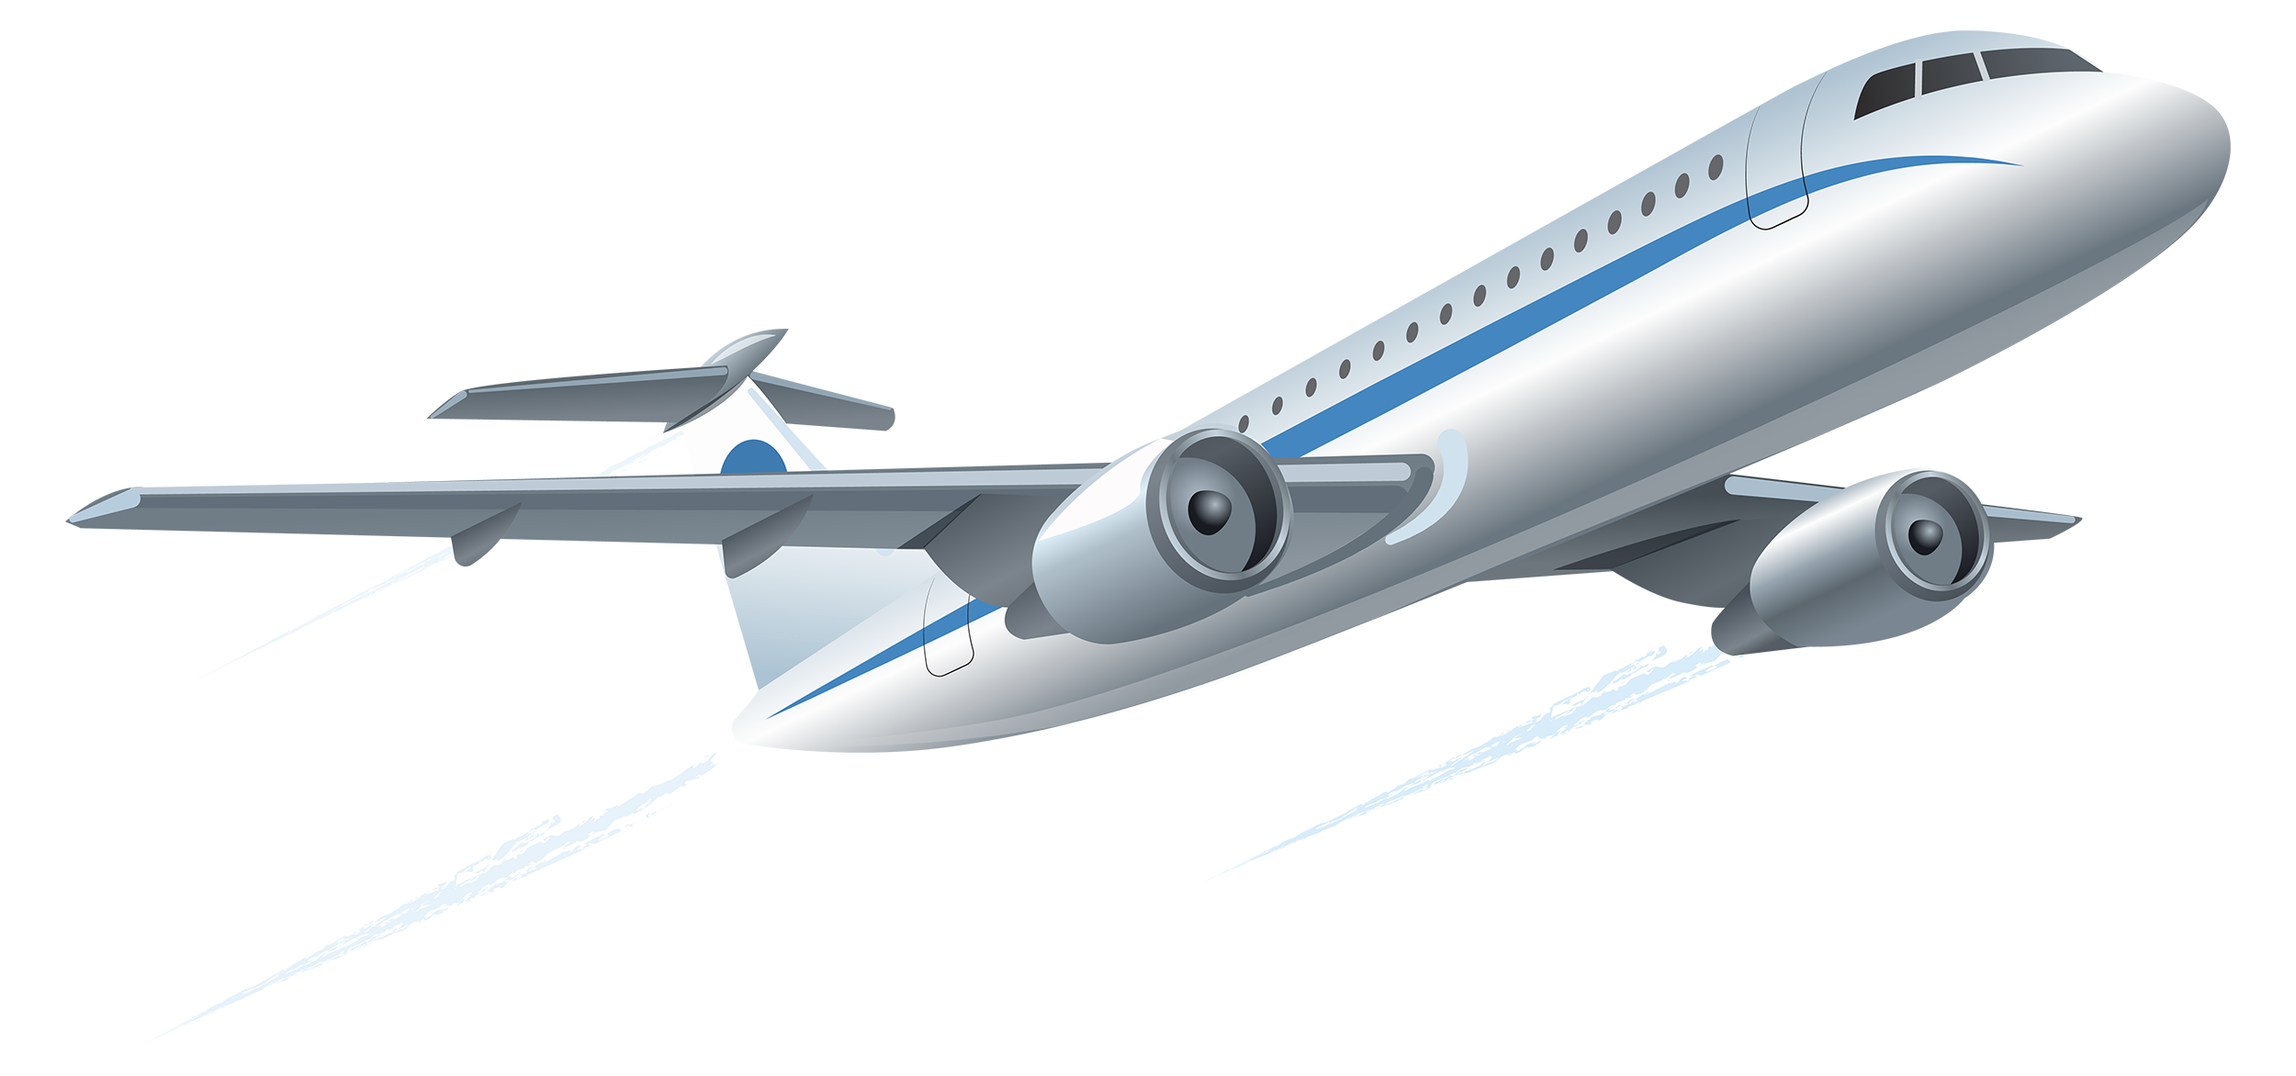
ARCHITECTURE OF FLIGHT BOOKING SYSTEM
Presentation Layer (Frontend): HTML/CSS: Responsible for the user interface and styling.
JavaScript: Handles interactivity and client-side validation.
Application Layer (Backend):
Web Server: Receives HTTP requests and routes them to the appropriate components.
Authentication and Authorization: Manages user authentication and authorization for secure access to the system.
Business Logic: Implements the core functionalities of the flight booking system.
API: Defines endpoints to expose functionalities for frontend and external integrations.
Database Layer:
Database Management System (DBMS): Stores and manages the system's data.
Relational Database (SQLite): Handles structured data related to users, bookings, buses, etc.

Slide 7

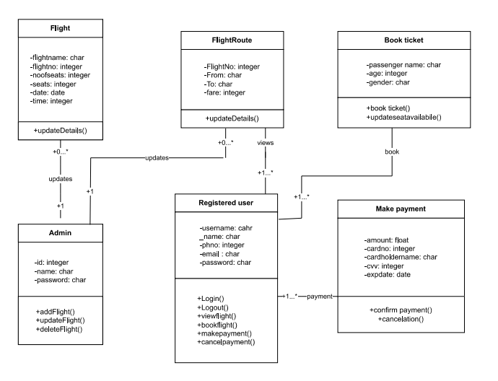
DATABASE (CLASS DIAGRAM)

Slide 8
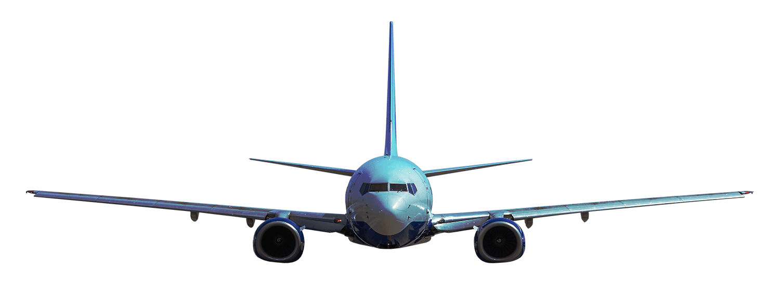
CHALLENGES FACED DURING THE DEVELOPMENT
User Authentication and Security: Implementing a robust user authentication system with appropriate security measures can be a challenging task.
Validation Mechanisms: Implementing validation mechanisms helps ensure that user input is accurate and consistent.
Designing User Interface: Creating an intuitive and user-friendly interface is crucial for a successful bus booking system.
Database Design and Management: Designing an efficient database schema and managing the database operations can be complex.
Testing and Bug Fixing: Thorough testing is essential to identify and fix any bugs or issues in the system.

Slide 9
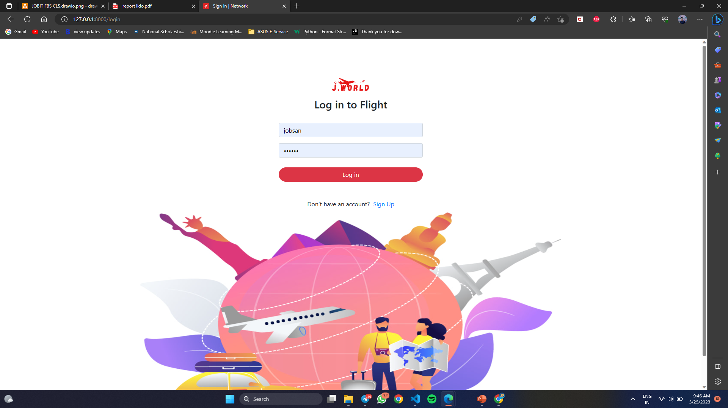
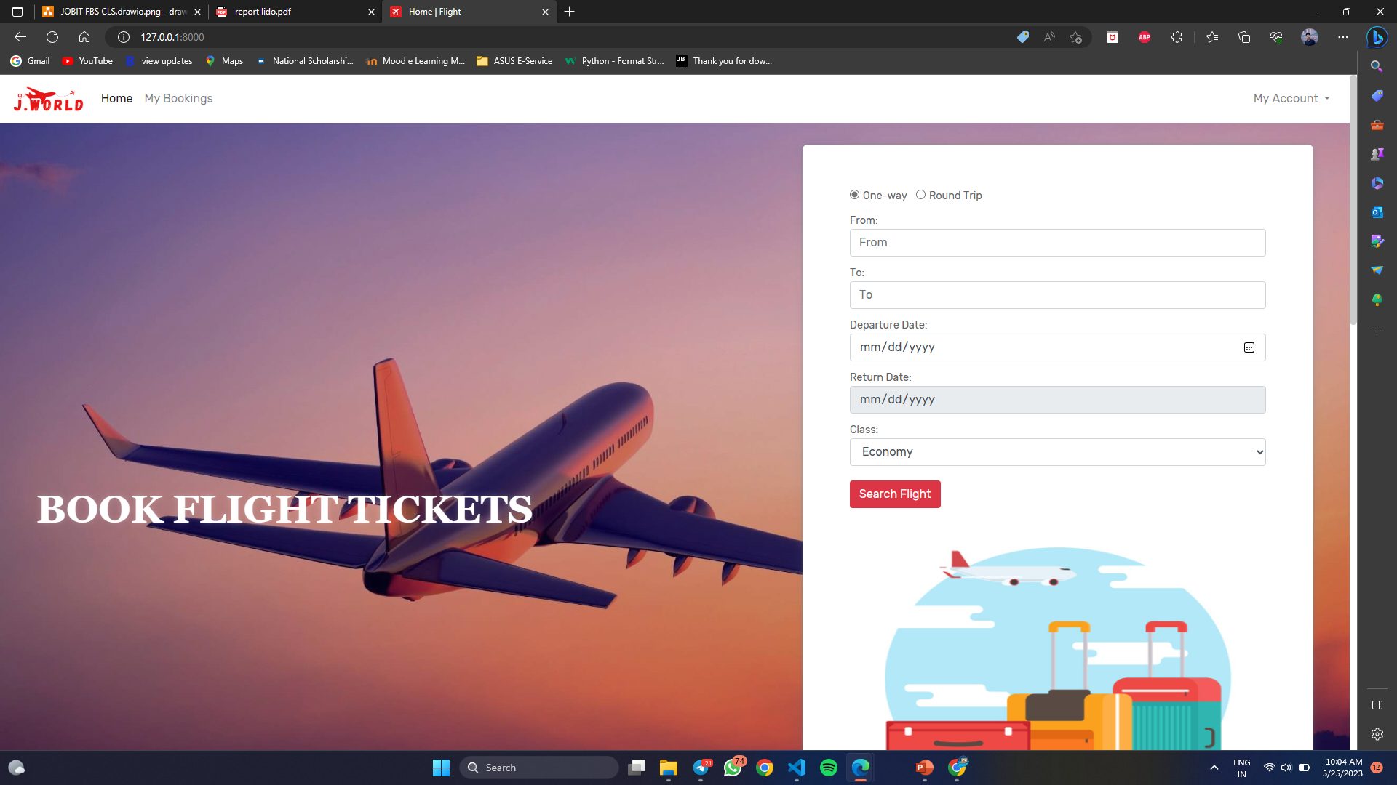
IMPORTANT SCREENSHOTS
Login: The login page is an essential component of a Flight Booking System as it allows users to authenticate themselves and access their personal accounts. It provides a secure gateway for users to log in and manage their bookings
Search Flight: search for available flights based on various criteria such as destination, departure date.

Slide 10
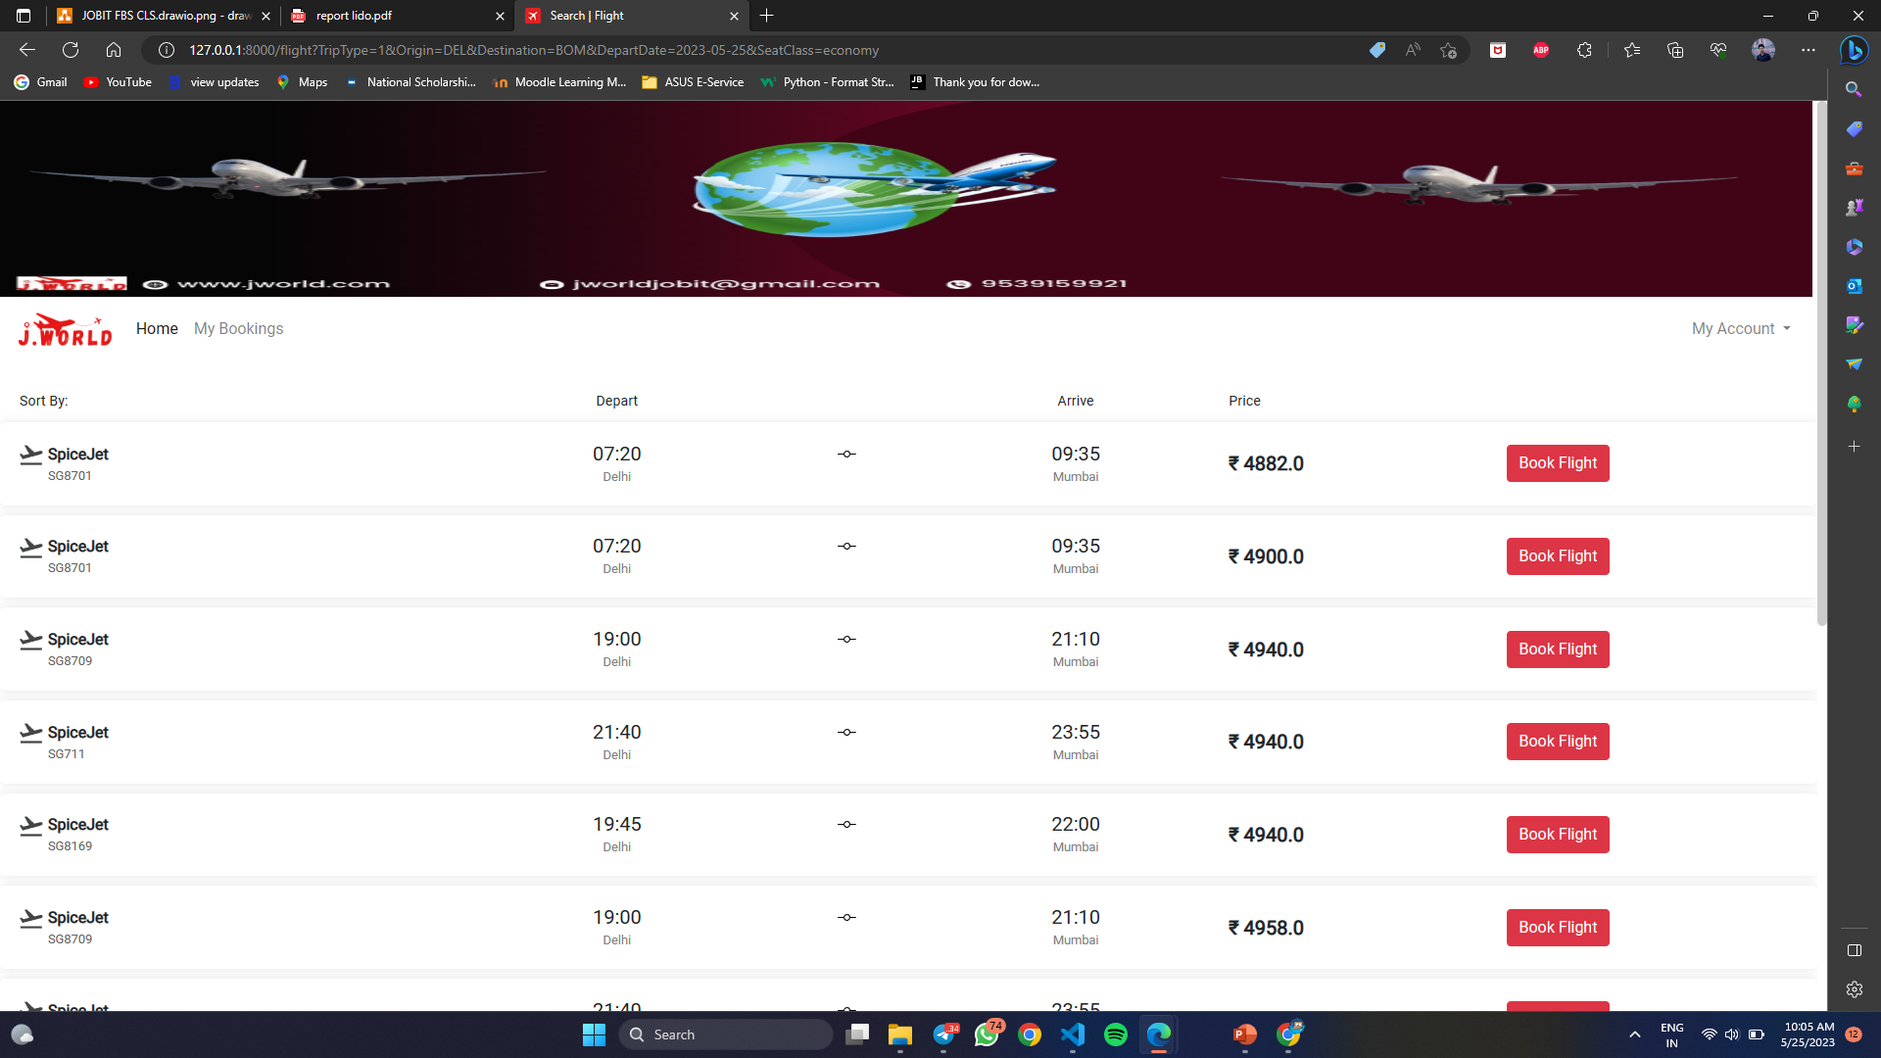
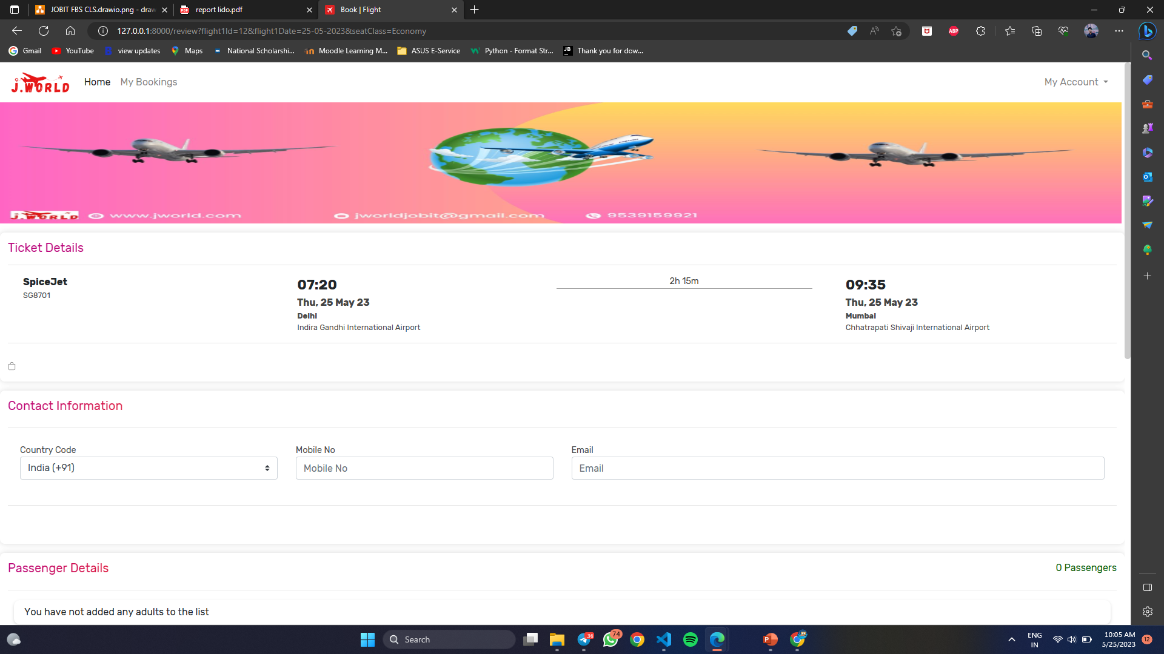
Flight List: The page displays a list view of the available flights that match the user's search criteria. Each flight listing typically includes information such as the airline name, flight number, departure and arrival times, duration and the fare for each ticket class.
Passenger Information: Users are required to provide passenger information for each traveler included in the booking. This information typically includes the passenger's full name, contact details, and any additional information required by the airline or booking system.

Slide 11
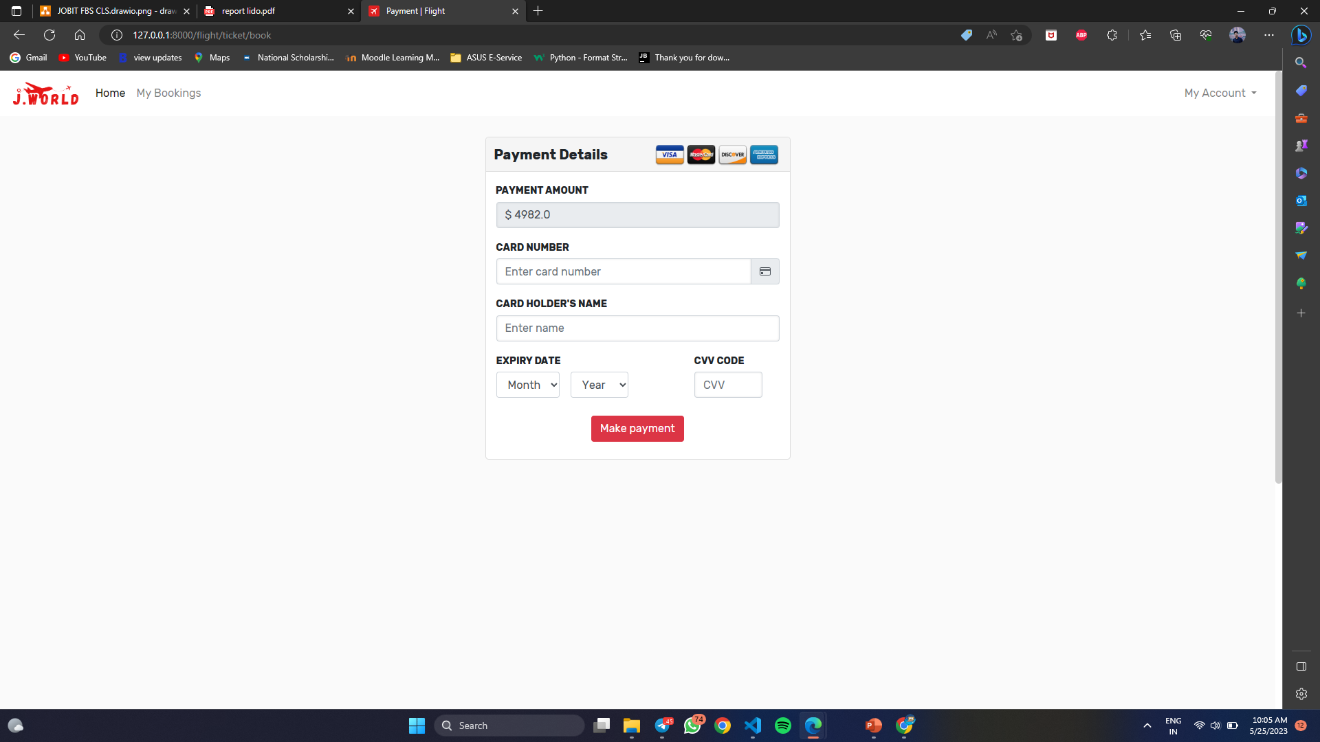
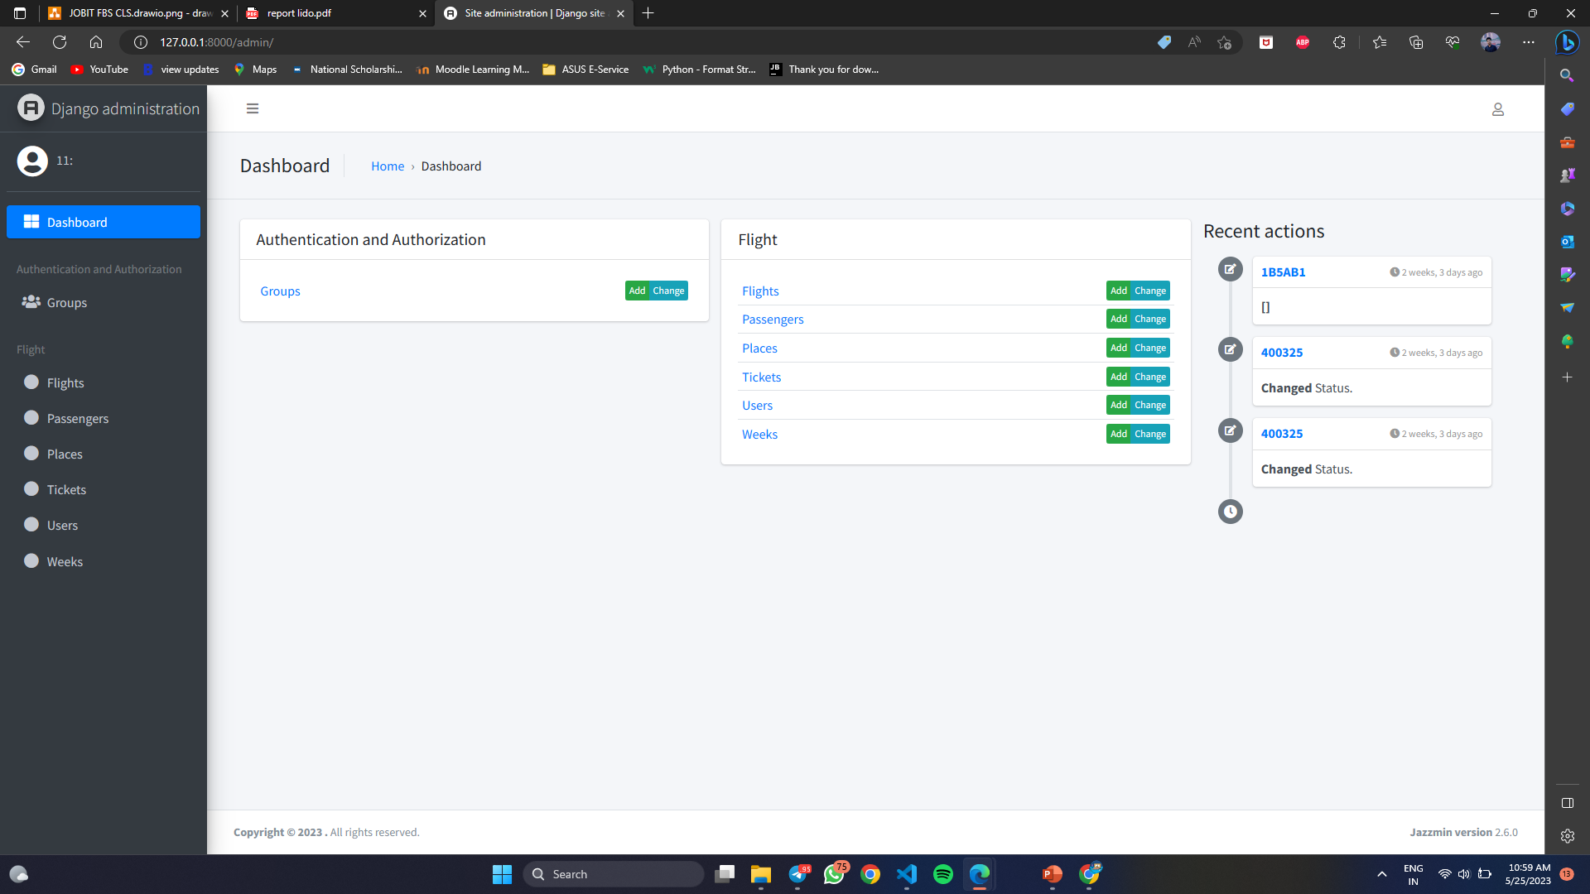
Payment Form: The payment page includes a form where users enter their payment details. This usually includes fields for the cardholder's name, card number, expiration date, and CVV
AdminDashboard: Upon successful login, administrators are typically presented with a dashboard. The dashboard provides an overview of important system information and statistics, such as the number of bookings, active flights, and other relevant data. It serves as a central hub for monitoring and managing the system.

Slide 12
FUTURE ENHANCEMENTS
Mobile Application: Develop a mobile application version of the Flight Booking System to cater to the growing number of users who prefer to book flights using their smartphones or tablets.
Personalized Recommendations: Implement a recommendation engine that utilizes user data and preferences to offer personalized flight recommendations.
Ticket: Like getting ticket as pdf format after the payment.

Slide 13
CONCLUSION
The proposed flight booking system offers a convenient and user-friendly platform for customers to book flight tickets. By leveraging technologies such as Python, SQLite, HTML, and CSS, the system streamlines the booking process and enhances the overall experience for passengers. The user registration module ensures privacy and allows registered users to access and book flight tickets for various destinations. The system aims to provide a consolidated resource where customers can conveniently browse and select their preferred routes, while maintaining the confidentiality of their personal information.

Slide 14
REFERENCES
https://youtu.be/YZvRrldjf1Y
https://docs.djangoproject.com/en/4.1/intro/tutorial01/
https://stackoverflow.com/

Slide 15
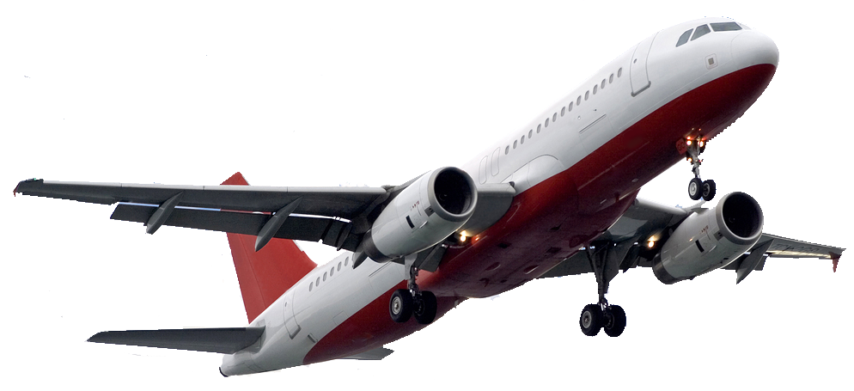
THANKYOU

